Slide 1
Sales Data Analysis for Chocolate Dataset(Chandoo owner)
Analysis Done in Excel

Slide 2
Questions and Objectives
The purpose of the analysis is to:
Analyse Sales By County to determine most profitable countries and where Highest sales volumes obtains.
Analyse Sales data By Product to determine which product are most profitable and recommend products to discontinue.
Determine the best salesperson per country

Slide 3
Data Cleaning and Processing
Sort the data by amount (formatted the amount column to currency and the sort newest on top) this was to make sure all amounts are correct and that outliers identified
Checked for duplicates
Applied trim on text columns to remove trailing/leading spaces
Converted the data set into an excel data table before analysis
Added calculated colunms to per products to cost per unit and calculate profit

Slide 4
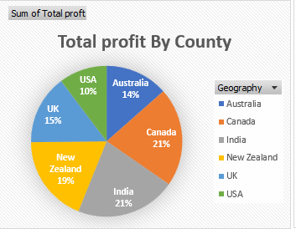
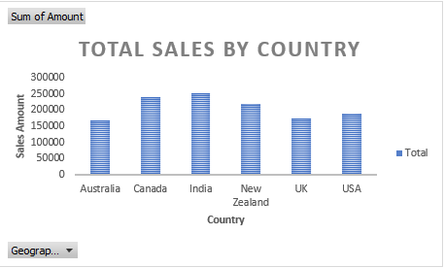
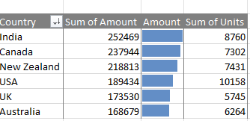
Analysis By Country
Analysis shows India, Canada and New Zealand Has the most sales volumes and are also the most profitable countries across products(aggregated)
USA has the most sold units, but the revenue is smaller which suggest less profitable products being dominant(explored under sales by Product)

Slide 5
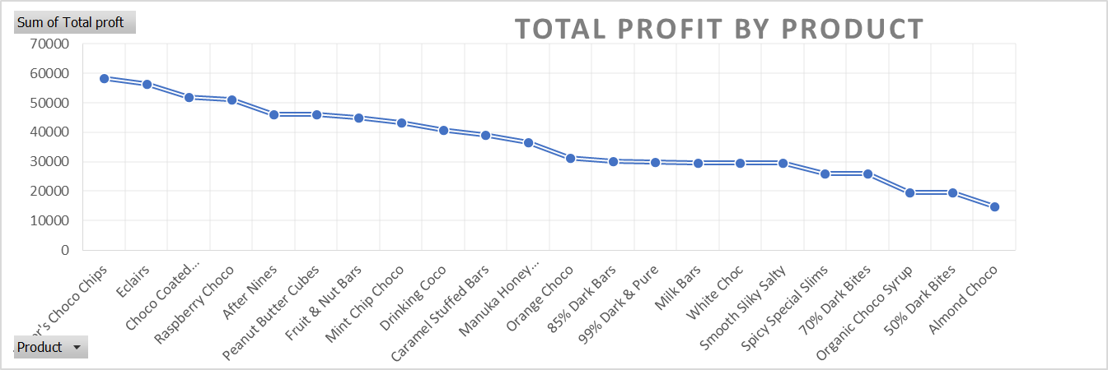
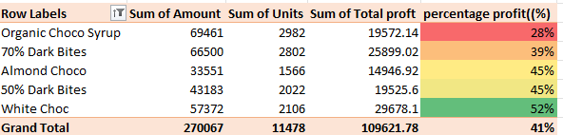
Analysis By Product
The Profit % analysis shows Organic Choco Syrup, and 70% Dark Bites are the least profitable
The profit by product shows same trend
However, a further analysis of product by country shows these products are profitable in other countries like Australia and product Almond Choco is preforming worse.
Recommendation is to discontinue products based on geography.

Slide 6
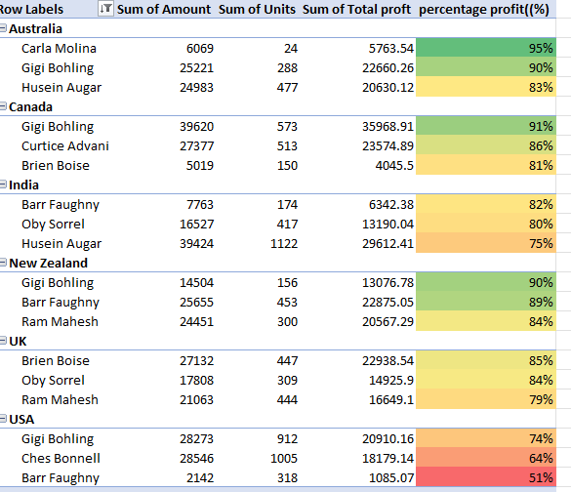
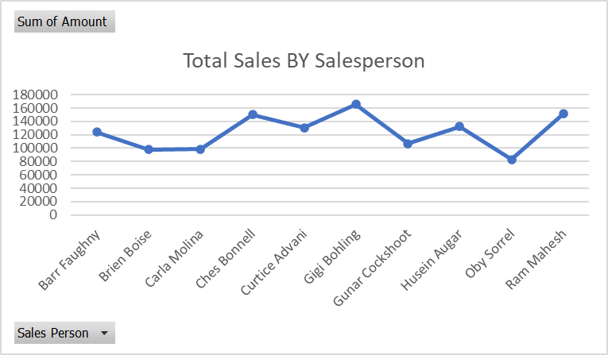
Analysis By Sales Person
Analysis of profit by salesperson indicates Gigi Bohling brings the most profit, However they do not make the most sales across countries.
Analysis Also shows he sales the most units on the most profitable Products

Slide 7
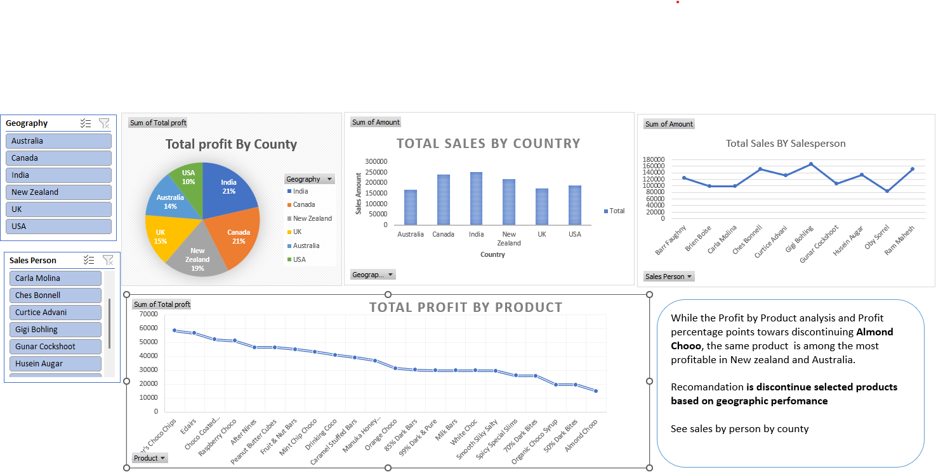
Dashboard

